Slide 1
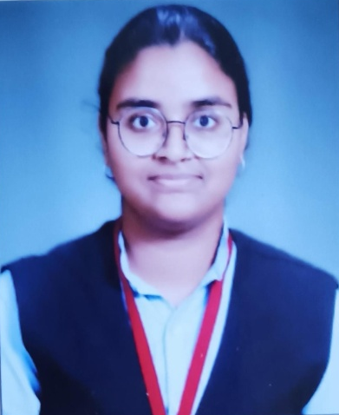
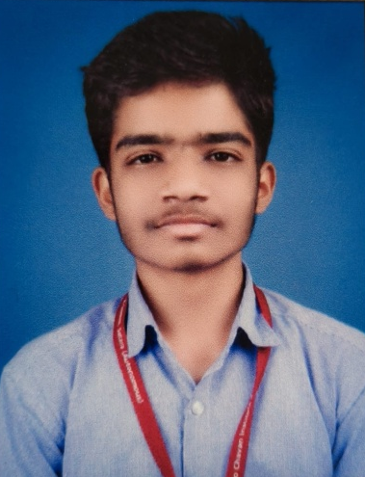
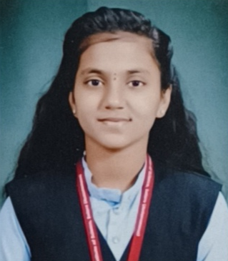

Rayat Shikshan Sanstha’s
Yashavantrao Chavan Institute of Science, Satara
Rayat Gurukul Academy
Students Qualified for JEE Advanced (2025)
Shinde Samruddhi Agatrao
92.15 percentile
Jadhav Sarthak Ramchandra
91.41 percentile
Shinde Shreyadita Balkrushna
82.97 percentile
Heartiest Congratulations !!!

